Slide 1
Filter Bubbles & Echo Chambers
Leo Wang

Slide 2
Definitions
A Filter Bubble is the potential extreme consequence of algorithmic personalization on the Internet. Which users can be lead to the misbelief that the info they are being fed is unbiased [1].
An Echo Chamber is a metaphor for an environment which a user’s existing beliefs are reinforced by the info they are surrounded by, potentially leading to group polarization [1].
Notes:
Note that echo chambers are independent of filter bubbles.

Slide 3
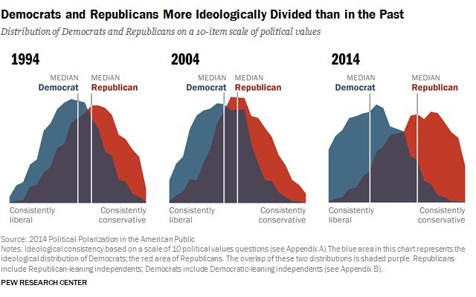
Political Polarization
Are filter bubbles to blame for recent political polarization?
Media has a significant effect on society (ex. Broadcasts in early 1900s).

Slide 4
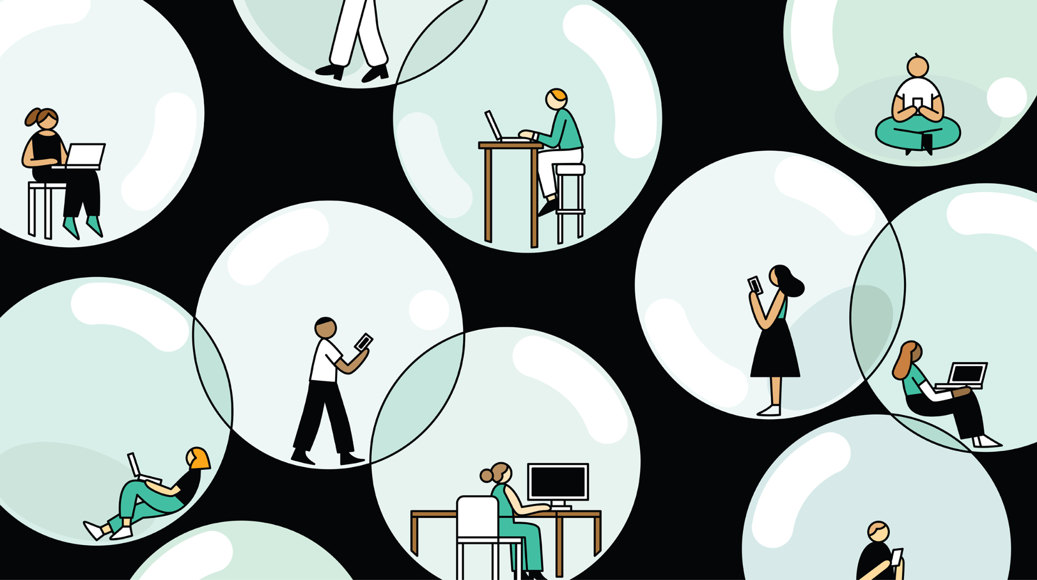
Why is this a concern?
It is argued that filter bubbles caused by algorithms can lead to echo chambers which can ultimately lead to group polarization.
Some fear this effect may undermine democracy as a whole [2].
Notes:
Note that political polarization is detrimental to diverse views.
Echo chambers additionally make it easier for misinformation to perpetuate within the group.

Slide 5
How do filter bubbles work?

Slide 6
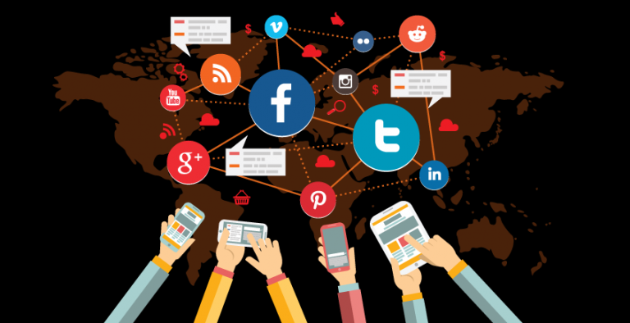
Online Personalization
People are attracted to others which they agree with [4].
Social media has motivation to display info which the user will be more likely to interact with.
Algorithms have been shown to personalize search results based on many factors (ex. Google Search, Netflix, Facebook feeds, etc.)

Slide 7
Online vs. Offline News Consumption
Online news is tailored by an algorithm and “unwanted” information can be automatically hidden [5].
Users do not choose to personalize their consumption.
Filter bubbles are possible due to the personalized nature of feeds [1].
Offline news is controlled by editors and publishers.
Filter bubbles (by our definition) are not possible offline [1].
User’s may still live in echo chambers because of selective biases.

Slide 8
What does the data show?

Slide 9
Studied Risk of Filter Bubbles
Only 4% - 8% of participants were shown to have risk of being in a filter bubble [1,2]
According to studies, only a small percentage of users could be at risk of being in a filter bubble [2].
Having a diverse media diet reduces the risk of filter bubbles.

Slide 10
However…
Limitations in formal papers in the topic note a diverse media diet does not mean less political polarization!
Evidence shows this can actually have the opposite effect [2].

Slide 11
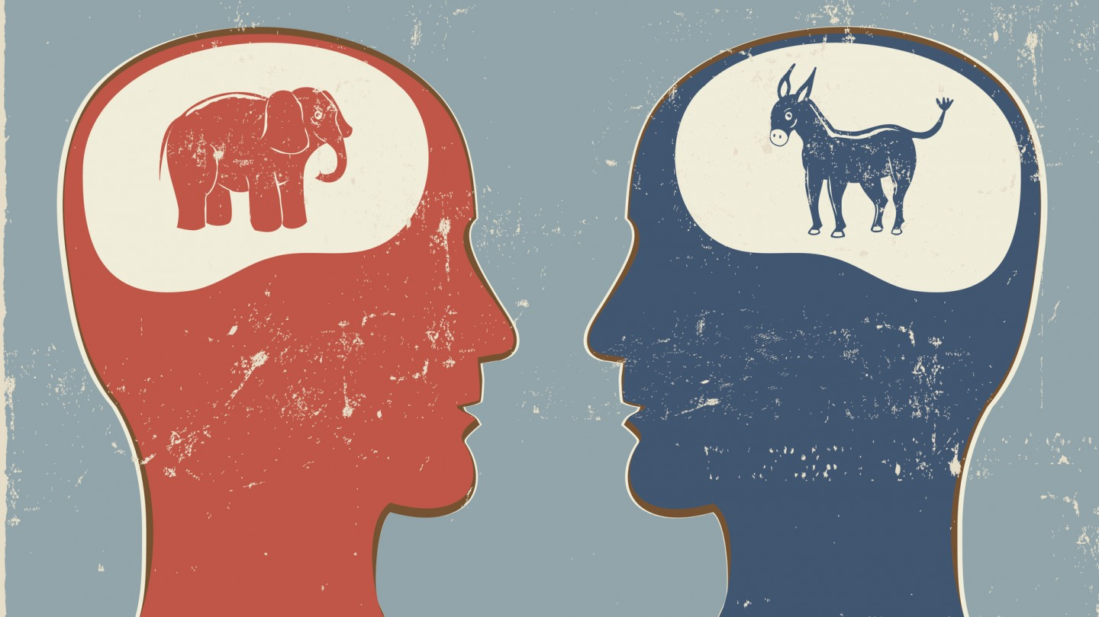
Thoughts &
Conclusion
What we can continue to think about.

Slide 12
The concern is real, but is only one factor
From conducted studies this phenomenon does exist, but the risk is not overwhelming.
May want to consider other factors like how people interact online into the equation.
We may want to consider the role of social media companies in all of this.
Eli Pariser argues that technology should be made to serve democracy.

Slide 13
References
C. Sindermann, J. D. Elhai, M. Moshagen, and C. Montag, “Age, gender, personality, ideological attitudes and individual differences in a person’s news spectrum: how many and who might be prone to ‘filter bubbles’ and ‘echo chambers’ online?,” Heliyon, vol. 6, no. 1, p. e03214–, 2020, doi: 10.1016/j.heliyon.2020.e03214.
E. Dubois and G. Blank, “The echo chamber is overstated: the moderating effect of political interest and diverse media,” Information, communication & society, vol. 21, no. 5, pp. 729–745, 2018, doi: 10.1080/1369118X.2018.1428656.
D. Robson, “The myth of the online Echo Chamber,” BBC Future, https://www.bbc.com/future/article/20180416-the-myth-of-the-online-echo-chamber (accessed Jul. 9, 2023).
The Conversation, “Most of US tend to be attracted to people who are similar to ourselves,” PsyPost, https://www.psypost.org/2017/03/us-tend-attracted-people-similar-48596 (accessed Jul. 9, 2023).
A. Walasek, “Algorithms, filter bubbles, and how personalization can change your perception,” epoint, https://www.e-point.com/blog/algorithms-filter-bubbles-and-how-personalization-can-change-your-perception (accessed Jul. 9, 2023).

